Slide 1

Team (3.05)

Slide 2
Team (3.05)

Slide 3

Nurse On Call
Team (3.05)
Team (3.05)
A trusted voice to empower patients in their care
5/16/2021
Notes:
A trusted voice to empower patients in their care

Slide 4
“An educated patient is an empowered patient”
Team (3.05)
– Dean Ornish

Slide 5
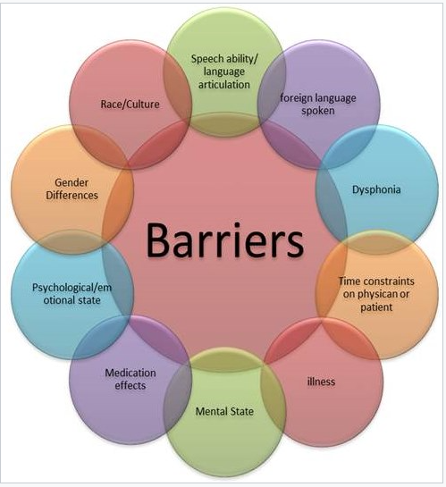
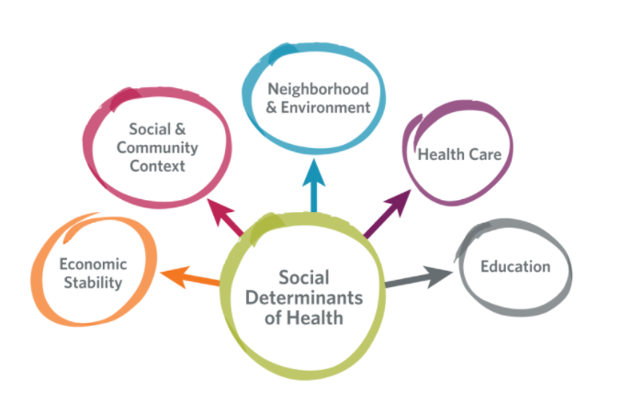
Team (3.05)
“Institutional distrust is more prevalent among racial/ethnic minority and low-socioeconomic status populations, especially African Americans; distrust is shaped by individual and collective experiences of injustice; ultimately, it is injustice that exacerbates health inequities.”
Notes:
Building Trust in Healthcare- “Environments of institutional distrust drive individualized perceptions of risk and decreased adherence to public health recommendations and interventions.”
“Perhaps one reason we have such a problem with patients not following their management plans is our attitude, as reflected in our lexicon. Medicine has a history of paternalistic and top-down approaches to patient care; patients had to follow our instructions, and if they did not, we labeled them “noncompliant.”
These words do not help us build trust with our clients/patients​

Slide 6
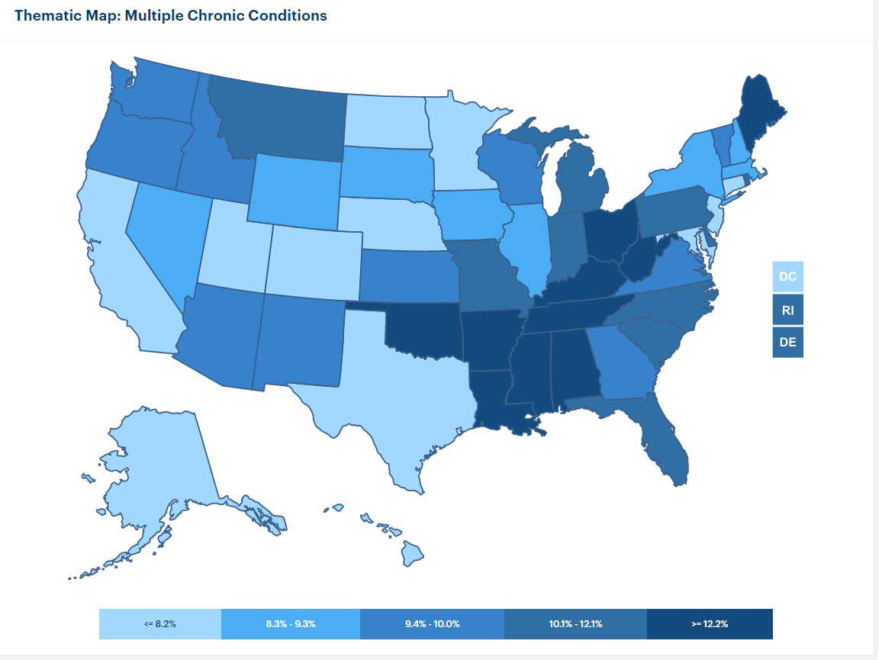
Team (3.05)
https://www.americashealthrankings.org/
Notes:
https://www.americashealthrankings.org/
Why not specify? Patients have multiple comorbities – concurrent disorders.

Slide 7
Currently Available Solutions
Team (3.05)
Currently there isn't an application available to promote patient advocacy by addressing healthcare literacy and patient understanding. ​
There are numerous online resources that are very informative, however the challenges with the health information sites are related to the patient's literacy level and understanding of the information provided, in addition to navigation and proper use.​
Notes:
" low level of health literacy—defined as “the degree to which individuals have the capacity to obtain, process, and understand basic health information and services needed to make appropriate health decisions.” The low level of literacy, may be based in poor reading skill, the complexity of medical information, or how information is delivered. Cultural and language factors also come into play." https://www.ncbi.nlm.nih.gov/pmc/articles/PMC1126218/#!po=10.0000 sz​

Slide 8
Our Solution vs. The Competition
Team (3.05)
Benefits​ | Nurse On Call​ | WebMD.com​ | MayoClinic.org​ | CDC.gov​ | Healthline.com​
Intuitive to Use​ | X​ | ​ | ​ | ​ | ​
Increases Accessibility to Resources | X​
Cost to Use​ | Free​ | Free​ | Free​ | Free​ | Free​
Accessibility​ | X​ | X​ | X​ | X​ | X​
Users​ | Patients/​ Clinicians​ | Patients/​ Clinicians​ | Patients/​ Clinicians​ | Patients/​ Clinicians​ | Patients/​ Clinicians​
Notes:
Need more details…
Videos
Local Resources
AI Questions
Connects with local Resources

Slide 9
Implementation Cost
Team (3.05)
The cost for this application would be a nominal fee or free to the patient.​
Funding sources:​
Targeted market will be patients in Louisiana and Texas (local hospitals or outpatient clinic settings). Application will be provided to all patients as a tool to use for questions and follow up. Promoting the patient to be involved in their care and treatment and helping to bridge the gap in health equity.
Private and State insurance companies ​
Pharmaceutical Companies​
Grants / Innovation Funding ​
Governmental Funding​
Notes:
Insurance companies can offer this service to patients to reduce readmissions

Slide 10
Scalability
Team (3.05)
Scalability is attained by starting with a pilot initiative focused on the patient populations in Louisiana and Texas. The targeted patients will be the disenfranchised and disadvantaged that don’t have access to primary care. ​
Will require a team approach for implementing the use of the application, involving the patient, healthcare provider or case manager.​
For the initiative to be successful will need participation and buy-in from the patient and healthcare team.​
With success of pilot implementation, can consider expanding to other disease processes and patient populations.
Notes:
Louisiana- Texas – Nationwide – Canada?
To get a comprehensive list of local resources

Slide 11
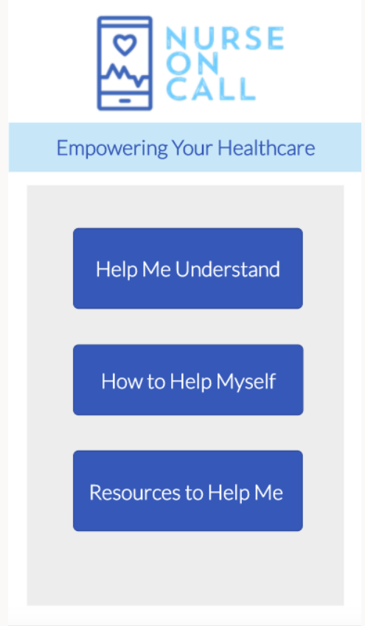
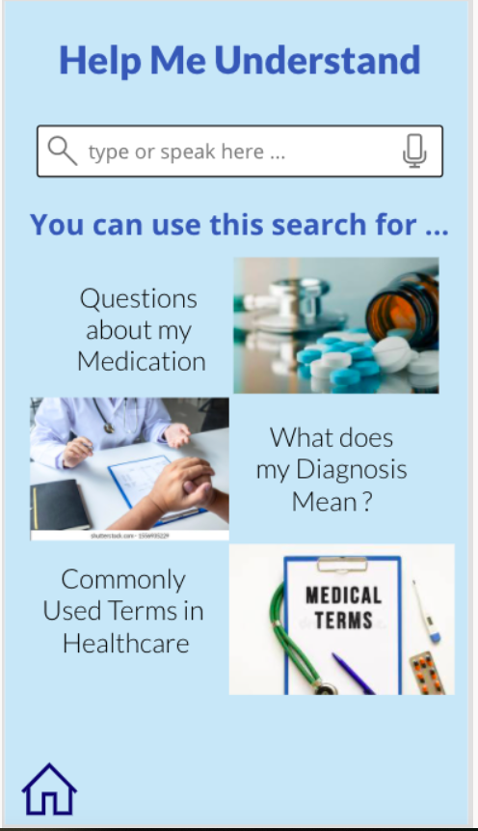
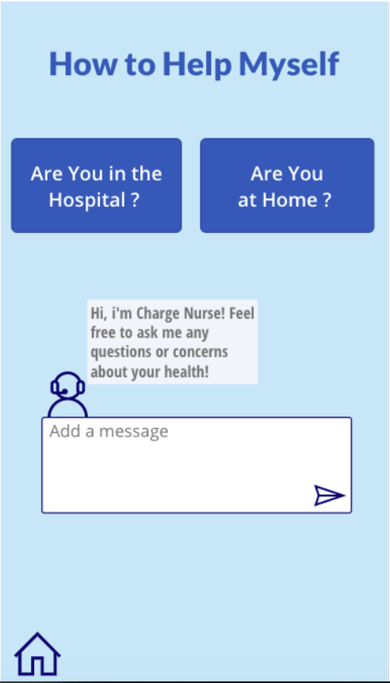
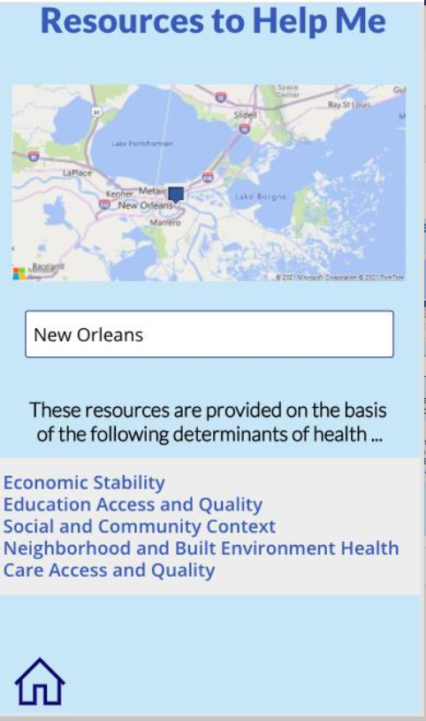
Nurse On Call
Team (3.05)
A trusted voice to empower patients in their care
Access to Education
Access to Advocacy
Access to Resources
Notes:
Nurse On Call will:​
Help patients become a more assertive healthcare consumer ​
Promote patient involvement in treatment decisions ​
Increase patient compliance of recommended treatment options
Nurse On Call is designed with a patient centered approach. This application provides information and connects to resources in a format that the patient understands. Improved Health literacy will empower the patient and promote increased compliance implementing the recommended treatment.​
Seek to partner with an existing data source ()
We will build commonly used terms
What make use different is its customizable and in one app instead of multiple. Plus, it connects patients to local resource. It also has an advocacy feature.
Trigger words (Diagnosis/ Medications) to prompt Resource's page and also the ability to self search.
App can read the information to you.

Slide 12
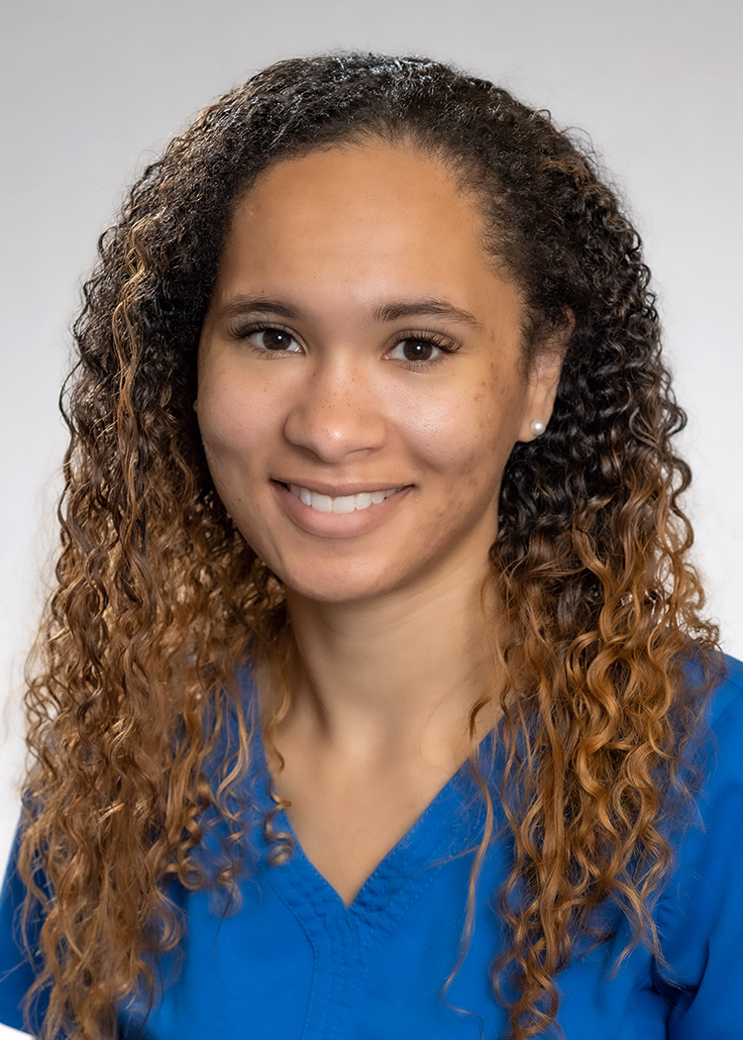
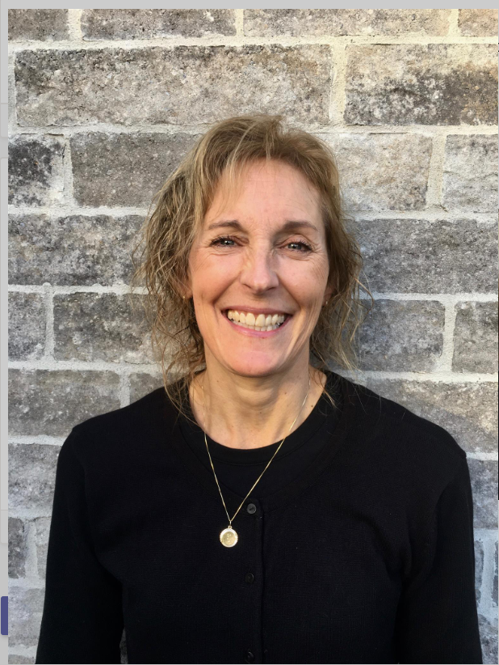
Nurse On Call Team -
Team (3.05)
Tracy Hobson has been a nurse for 24 years practicing in the community in Public Health and a Hepatitis C Treatment Nurse. Her background includes working with marginalized populations, harm reduction, focusing on treatment of STBBI's, substance use and mental health, health equity and health advocacy for clients.
Ahnyel Burkes has been a nurse for 8 years. She is the Director of Health Policy and Advocacy for the Louisiana State Nurses Association. She has experience in Medical Surgical ,Telemetry , Progressive Care, , Stepdown Care, System Quality and Post-Acute Care .
Ahnyel Burkes, DNP, RN-BC
Tracy Hobson

Slide 13
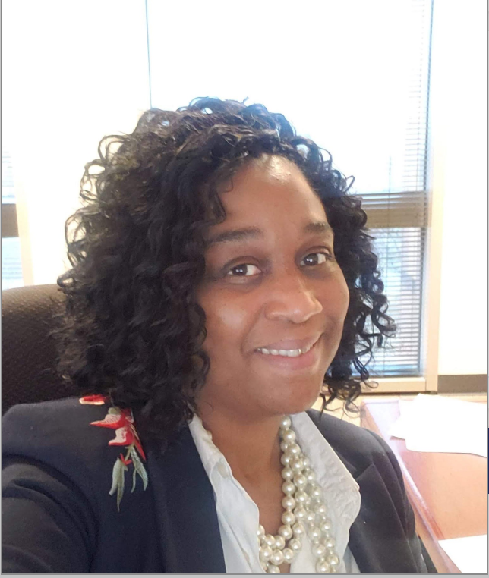
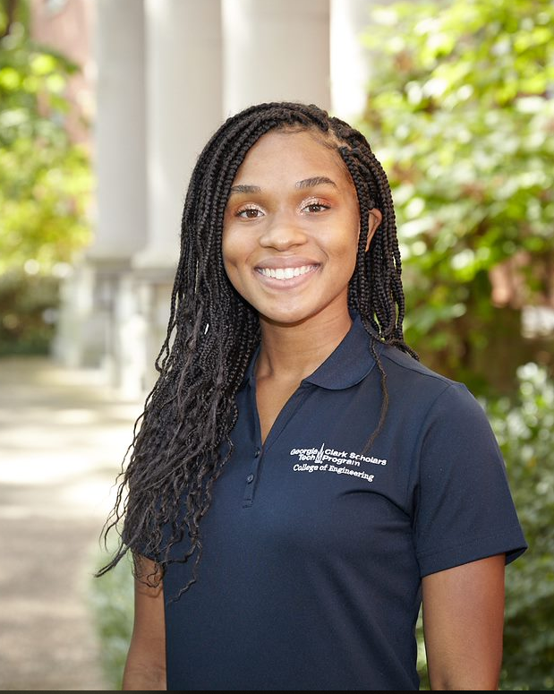
Nurse On Call Team -
Team (3.05)
Cicely Cyphers, RN, MSN has approximately 20 years nursing experience comprised with areas of focus in Obstetrics/Gynecology, Population Health and Home Health.
Azalia is a rising 2nd Year Biomedical Engineering major at the Georgia Institute of Technology from Austin, Texas. She is studying with a Pre-Research concentration and is excited about the future of innovation within the Healthcare Industry.
Cicely Cyphers, RN, MSN
Azalia Cyphers

Slide 14

Questions?
Team (3.05)

